Slide 1
Optimal Adversarial Pathway Estimation Using Remotely Sensed Spectral-Terrain Data: A Graphical Modeling Approach
Josef Affourtit, Summer Intern
Ohio State University, Dept. of Physics
Dr. Nicholas Scott, Modeling Scientist
Riverside Research
Open Innovation Center
Michael Nelson, Executive Director
Shawn Kalis, Associate Director
Riverside Research
Intelligence Defense Solutions Directorate
2019 MORS Conference

Slide 2
Outline
Intelligence Problem Statement and Spatial Optimization Approach to Geo-Intelligence Analysis
Our Problem and Global Solution Methodology
Algorithm Methodology: Image Chip Formation, Dictionary Learning
Value Field Formation From Matched Filter, OMP, Spatial Gradient, Laplacian Eigenmap
Reward Field Estimation from Value Field
Optimal Pathway Estimation - Q-learning and SARSA: Comparison of Maximum Q learning policy, Maximal SARSA learning policy, and Dijkstra algorithm examples
Conclusions

Slide 3
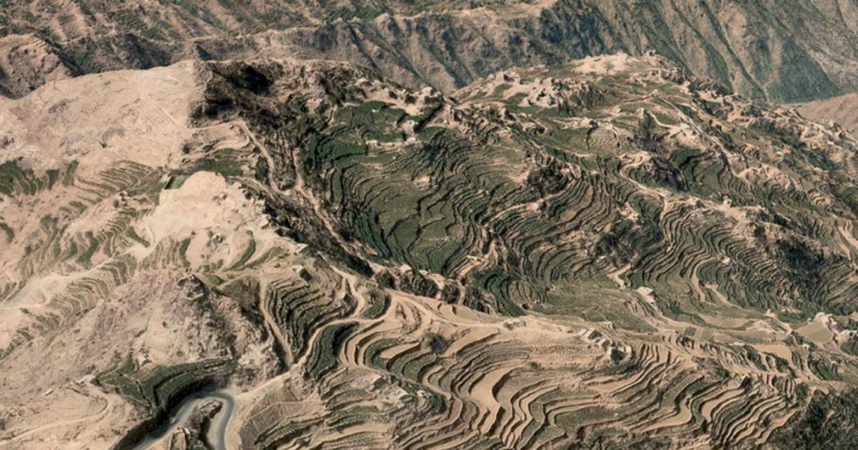
Spatial Optimization for Geo-intelligence Analysis
Information Source Ranking
for Mission Planning
Bayesian Belief Networks for Adversarial Location Estimation
Enemy Deception
Estimation
Optimal Path Estimation
for Mission Planning

Slide 4
Spatial Optimization Approach to Geo-intelligence Analysis
Intelligence agencies often possess high spatial resolution remote sensing data along with a need to accomplish certain objectives stemming from different mission directives
Optimization-based algorithms such as probabilistic graphical network analysis can be applied to such data to facilitate decision making in the form of rational environmental state assessment
In particular, reinforcement learning where human value assessment is interjected, can assist in finding pathways through regions of interest where precious resources should be focused

Slide 5
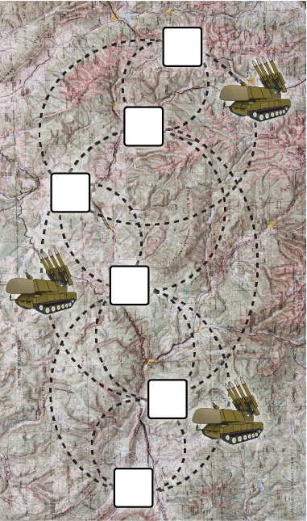
Intelligence Problem Statement
Adversarial areas monitored from EO satellite remote sensing platforms (MSI, HSI, and panchromatic) allow the opportunity to perform activity-based geo-intelligence analysis
One problem of great importance to
agencies is the mobile missile problem
(MMP)
MMPs constantly move across terrains
prompting a need to understand 2 things:
a) Optimal adversarial locations for MMPs
b) Optimal pathways across the terrain
given remotely sensed ground structure

Slide 6
Our Problem and Global Solution Methodology
Using open source RIT HSI data, optimal pathway estimation can be addressed using a two-phase processor
A) Feature Extraction
A) Spectral terrain data is divided into image chips
B) Image chip data is distilled into average characteristic quantities
representing local structure
C) Image chips are scored according to a functional rule, transforming
local areas in optimal value fields
B) Spatial Optimization
i) Probabilistic graphical network consisting of nodes and edge is
created. Nodes parameterize image chip locations
ii) Value field mapped to reward field and utilized in a reinforcement
learning algorithm to estimate optimal pathways

Slide 7
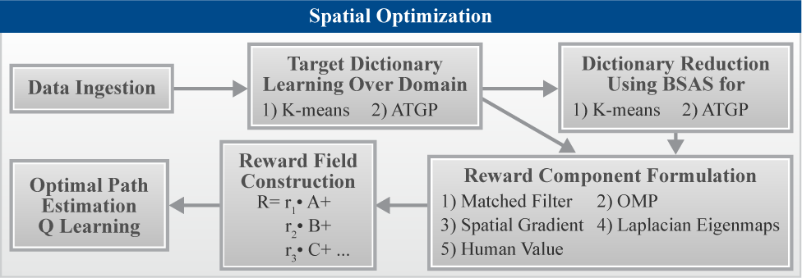
Algorithmic Methodology
Value

Slide 8
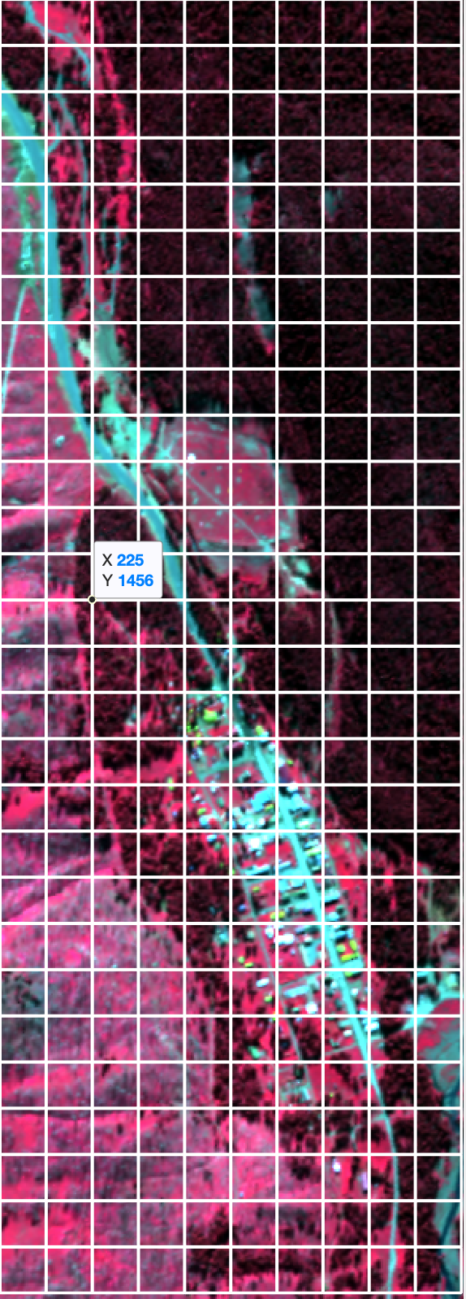
Data Ingestion, Image Chip Formation, Preliminary Pre-Processing
Load HSI image
Cut HSI image into 32 x 32 pixel
image chips
Performing PCA on image chips
Dimensionality Reduction
Decrease contribution from noise
First 20 bands used in processing

Slide 9
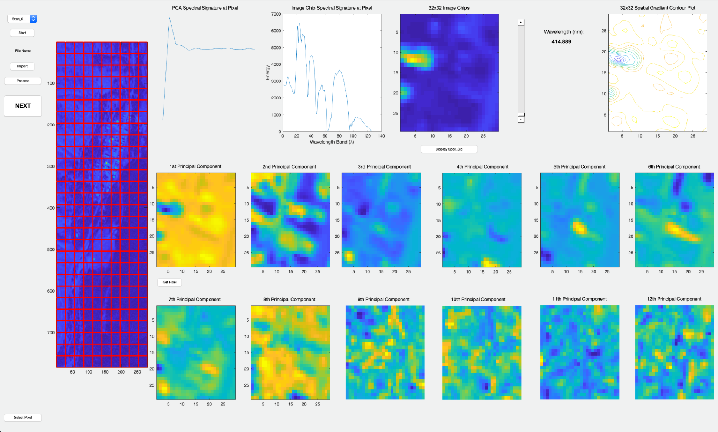
Data Ingestion PCA - GUI

Slide 10
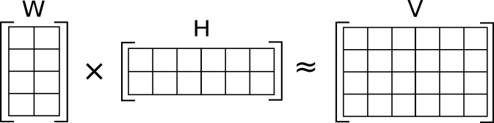
Target Dictionary Learning
Estimation of spectral dictionary endmembers, W using unsupervised learning
Methods include: Automatic Target Generator Processing, K-Means Clustering
Needed to solve Y= W * A for A -> value field estimation
7 or 13 Spectral Endmember Dictionary Abundances ? HSI spectral signature data
Y
A

Slide 11
Value Field Formation
Application of feature extraction algorithms allow for image chip value estimation
Filter Algorithm(image chip) and criteria -> image chip value
5 different algorithms for calculation of 5 value fields
Abundance Estimation via Nonnegativity Constrained Least Squares Matched Filter* (complete spec. dictionary)
Abundance Estimation via Orthogonal Matching Pursuit* (overcomplete spec. dictionary)
Spatial Spectral Gradient
Laplacian Eigenmap Kurtosis
Human Value

Slide 12
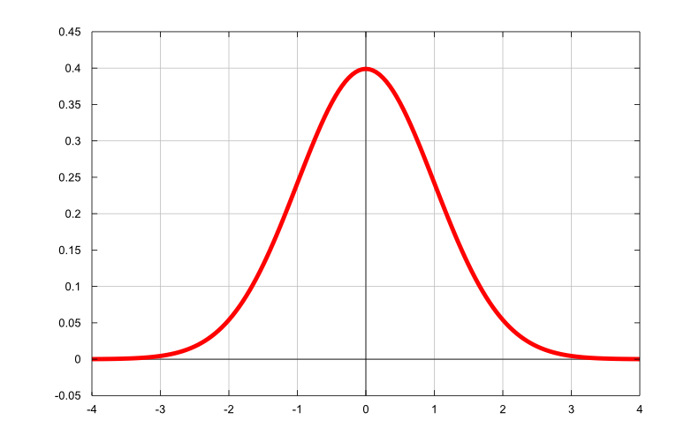
Value Field Formation – Cont.
Abundance Estimation via Nonnegativity Constrained Least Squares Matched Filter
Image chip abundance estimates derived using BSAS based reduced complete spectral target dictionary
Characteristic spectral signatures for each image chip derived from max abundance estimates
Value Criterion: Mahalanobis distance using characteristic spectral signatures and median HSI spectral signature of entire data set
Value ~ MD(median HSI sig, char. spec. sig.)
High MD -> physical structures unlike dirt
-> bldg. & paved road area
-> high value
MSS = dirt
CSS = bldg.

Slide 13

Value Field Formation – Cont.
Abundance estimation via Orthogonal Matching Pursuit
Image chip abundance estimates derived using an overcomplete spectral target dictionary and sparsity
Characteristic spectral signatures for each image chip derived from max abundance estimates
Value Criterion: Euclidean distance using characteristic spectral signatures and the mode HSI spectral signature of entire data set
Value ~ ED(mode HSI sig, char. spec. sig)
High ED -> physical structures unlike dirt
-> bldg. & paved road area
-> high value
MSS = dirt
CSS = bldg.

Slide 14
Value Field Formation – Cont.
Spatial Spectral Gradient
Spatial spectral gradient (SSG) of first PCA component of HSI spectral radiance used
Value ~ 1/SSG
Low SSG -> paved road like area -> high value
Laplacian Eigenmap Kurtosis
First Laplacian eigenface (LE) for each image chip is calculated
First LE is high kurtosis image and allows for exhumation of small anomalies
Value ~ 1/kurtosis(first LE)
Low kurtosis -> paved road like area -> high value

Slide 15
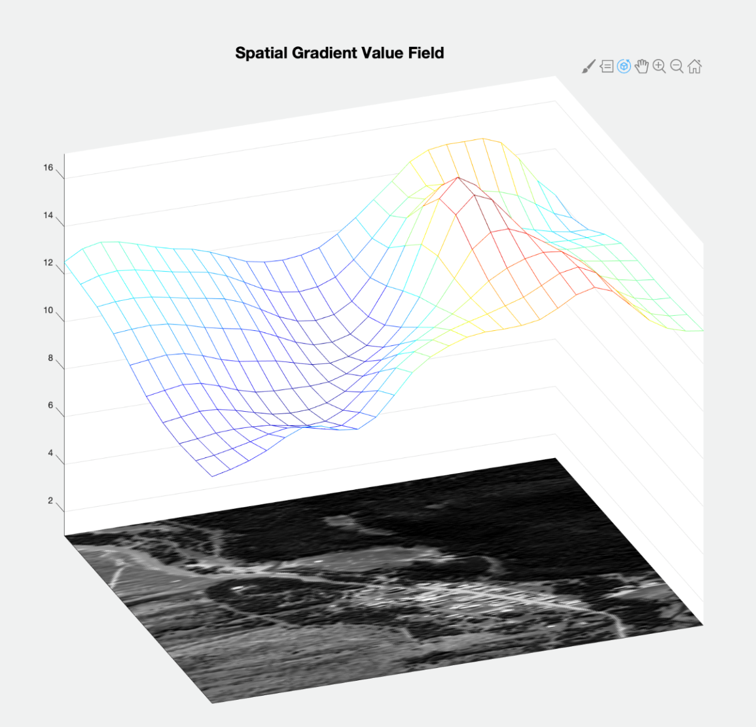
Example Value Field – Spatial Spectral Gradient
Low Value ~
High S.S.G.
High Value ~
bldg. & pave road
spec sig. ~
Low S. S. G.

Slide 16
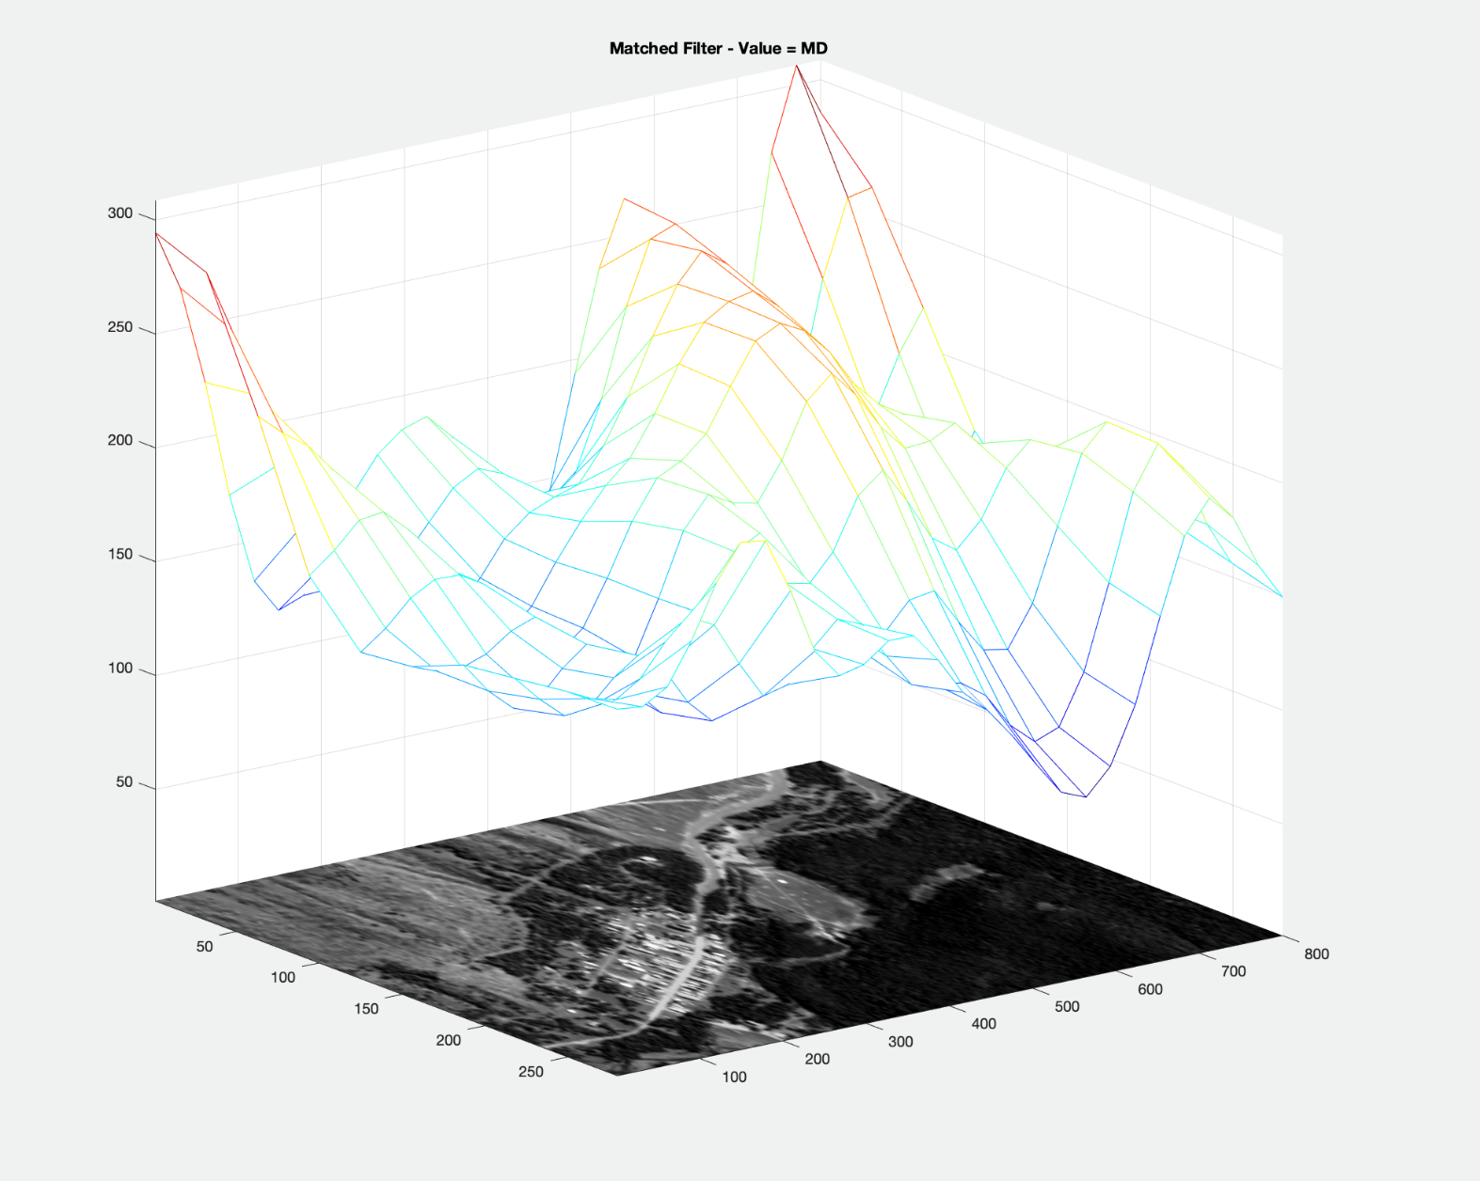
Example Value Field – Matched Filter
High Value
~ bldg. & paved
road spec. sig.
Low Value
~ dirt like spec. sig.
NOISY !

Slide 17
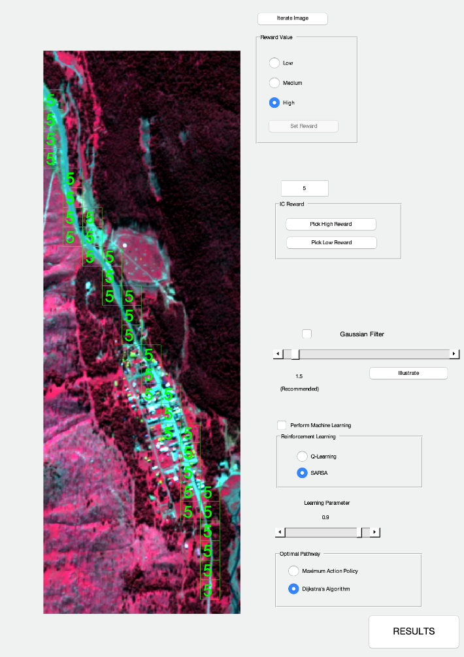
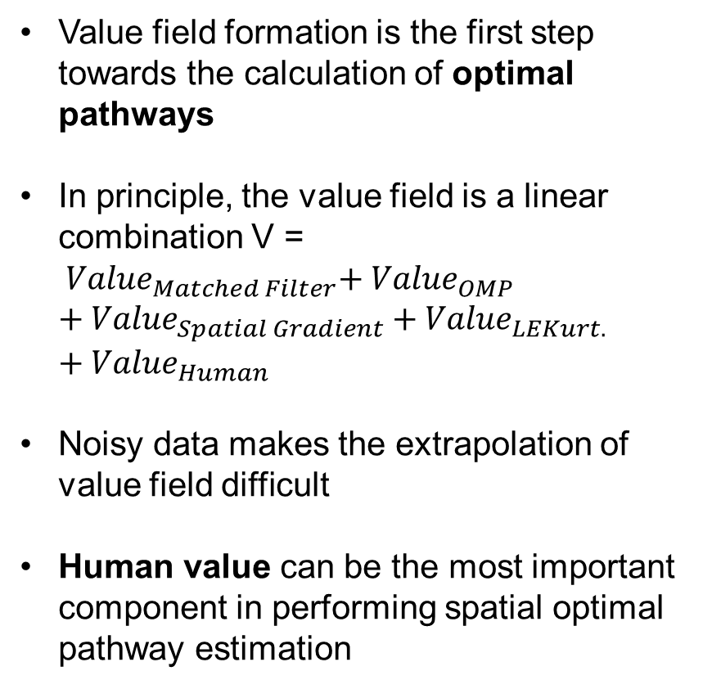
Value Field Examples using Human Value - GUI
Value field formation is the first step towards the calculation of optimal pathways
In principle, the value field is a linear combination V = ${ Value}_{Matched Filter}{+ Value}_{OMP}$ ${{+ Value}_{Spatial Gradient}+Value}_{LEKurt.}$ ${+ Value}_{Human}$
Noisy data makes the extrapolation of value field difficult
Human value can be the most important component in performing spatial optimal pathway estimation

Slide 18
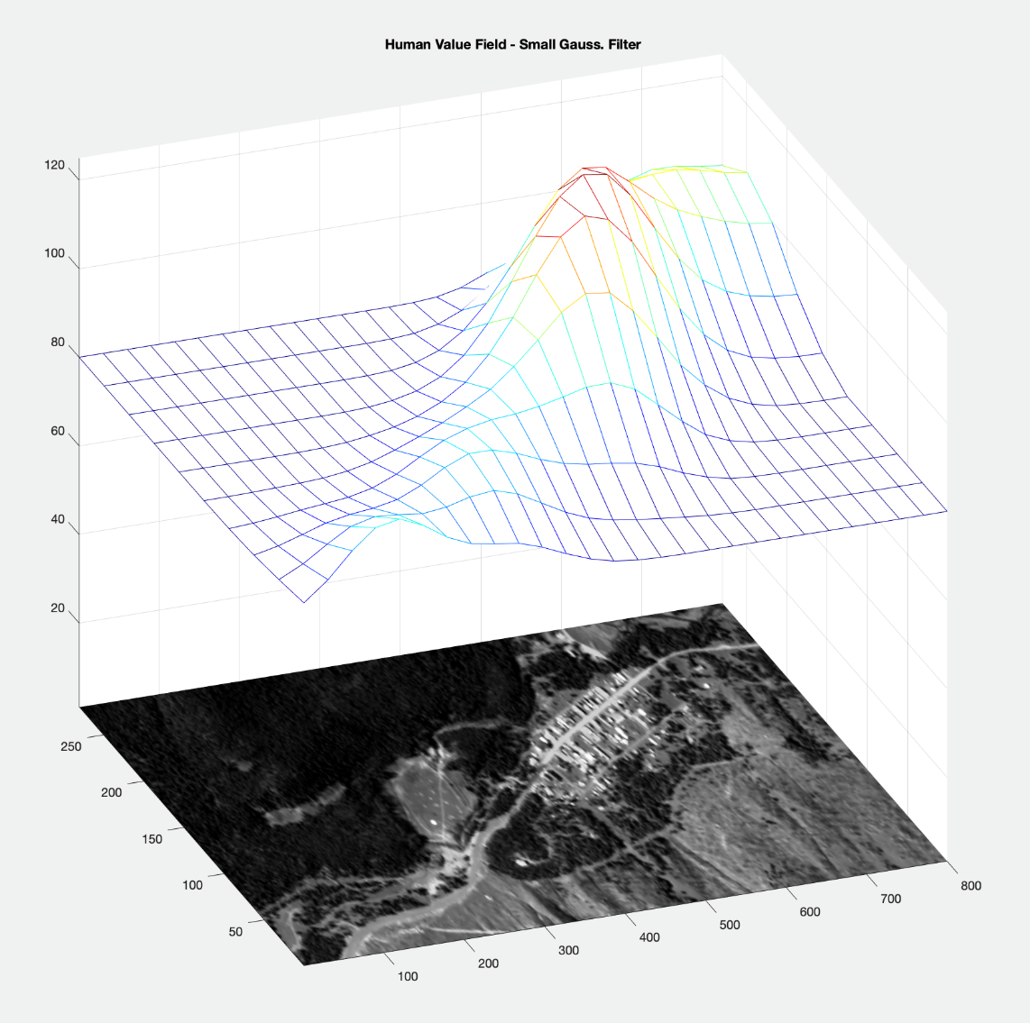
Value Field – Human
High Value
Low Value

Slide 19
Spatial Optimal Pathway Estimation: Q-learning and State-Action-Reward-State-Action (SARSA) Learning
Q-learning and SARSA: Procedural methodologies which uncover the optimal state sequence structure for an environment
Q-learning and SARSA systems have 2 parts:
Agent = the entity which learns
Environment = where learning takes place and what is being learned about
Environmental data: reward/feedback as to what is ‘good’ or ‘bad’
No information is given as to what should actually be done

Slide 20
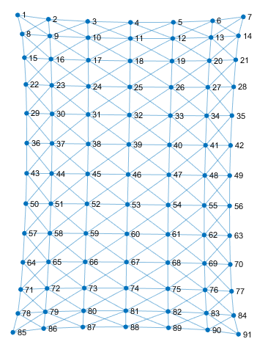
Mathematical Modeling for Reinforcement Learning
Probabilistic Graphical Network:
Nodes –> image chip characteristic values
Edges –> transition pathways between image chips
Instant Rewards - degree to
which nodal transitions are
‘good’ or ‘bad’
High reward values = Useful thoroughfares for reaching the end state

Slide 21
Q-Learning Definitions
Q-learning and SARSA learning problem is defined by
Current state, s
Current action, a
Transition function, T(s,a) = s’ How to move from s to s’ !
Instant Reward Field, R(s,a)
Value Field → Instant Reward Field
Utility function, Q(s,a)
Discounted cumulative reward for taking action ‘a’
from state s

Slide 22
Q-Learning Utility Function
Q(s,a) = utility function quantifying how good an action is given a certain state
= r(s,a) + γ F
Best value of rewards to come in the future when another state is transitioned into by a randomly taken action.
Immediate reward for performing an action ‘a’ in state ‘s’
γ = parameter between 0 & 1.
Balances effect of immediate reward vs. relative value of delayed rewards from the future.

Slide 23
Q-Learning Algorithm Procedure
Optimal policy→ trial and error learning search
Find path that maximizes cumulative reward over many state-action transitions from various starting points
Iterative algorithm:
Episodically pursue all pathways from various points
Choose actions ‘a’ that maximize Q when in any state ‘s’
Eventually after many episodes optimal Q function attained
Learning Agent
Internal state
Perceptions
(s)
Action
(a)
Reinforcement (+/-)
R(s, a)
Environment

Slide 24
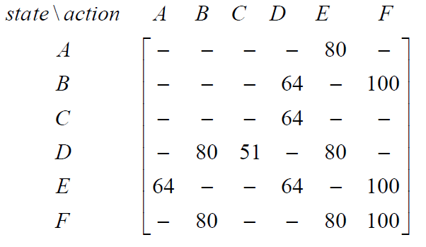
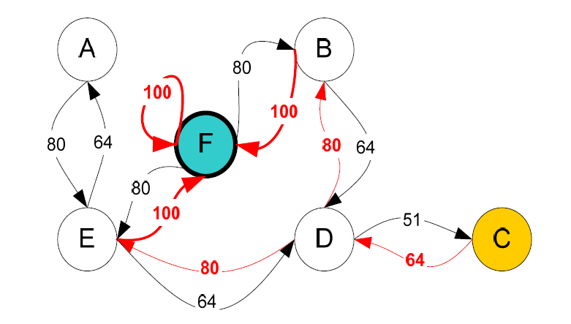
Value Field to Instant Reward Field Estimation
Spatial optimal pathway estimation emanates from Q-Learning and SARSA
Q-Learning and SARSA are contingent on estimates of the Instant Reward Matrix
Instant Reward Matrix = R(state, action) emanates from the Value Field
Each nodal state element of R has a reward attained by virtue of mapping into that nodal state
End Result -> Q(s,a)

Slide 25
Dijkstra’s Algorithm
Dijkstra’s Algorithm actually finds the path of least steps and cost
Resulting Q(s,a) from Q-learning and SARSA has high values indicating high rewards for the agent to follow
In the Dijkstra Algorithm large Q values ~ large costs and would actually be avoided. Therefore, invert Q(s,a) elements
Inverted Q(s,a) = cost field where the smallest values are the least costing
Dijkstra’s Algorithm applied, and optimal path found based on the smallest steps and the largest Q(s,a) rewards

Slide 26
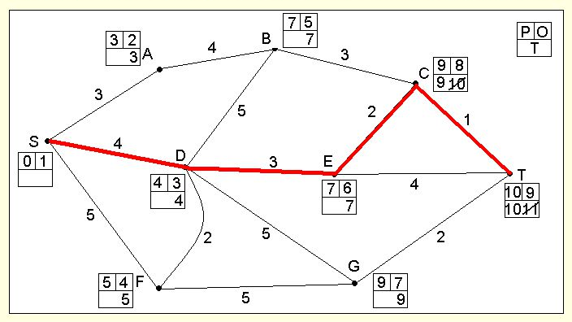
Dijkstra Algorithm cont.
From each node, the algorithm determines the least cost action, and moves to that node
Using the Q-Matrix from reinforcement learning, Dijkstra’s algorithm finds the most rewarding path in the smallest number of steps
T(s,a)
No T(s,a)
Q(s,a) or SARSA
Q(s,a) or SARSA
Max Action Policy
Dijkstra’s Algorithm
Optimal Pathway
Optimal Pathway

Slide 27
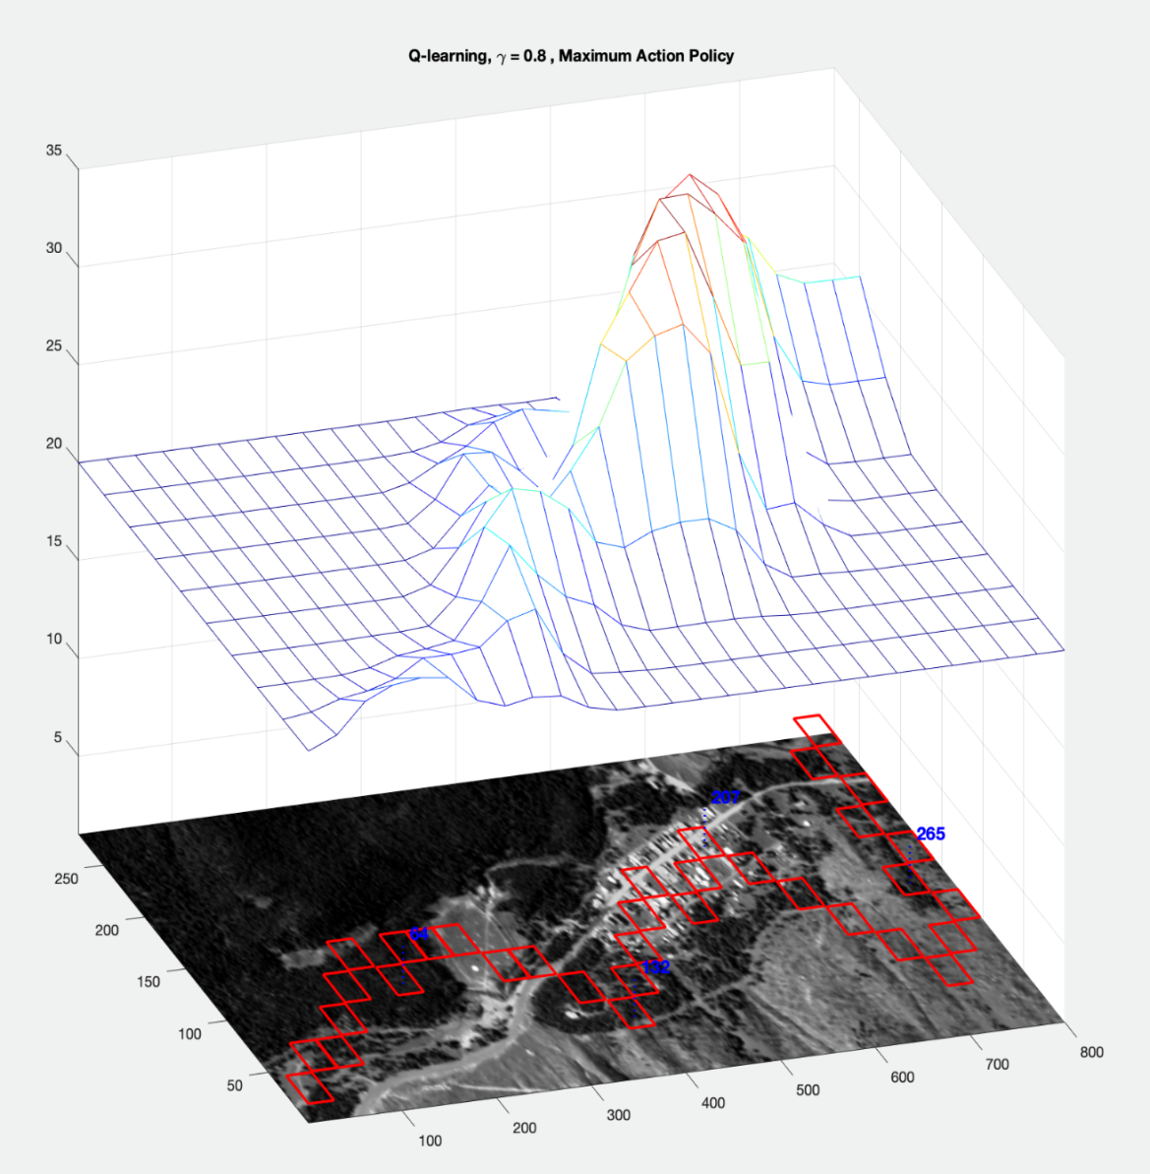
Optimal Pathway – Human Value Field
Q-Learning γ = 0.8
Maximum Action
Policy
Large γ allows for
massive nodal state
field exploration
Places more emphasis
on future estimates
Optimal path takes agent all over the image

Slide 28
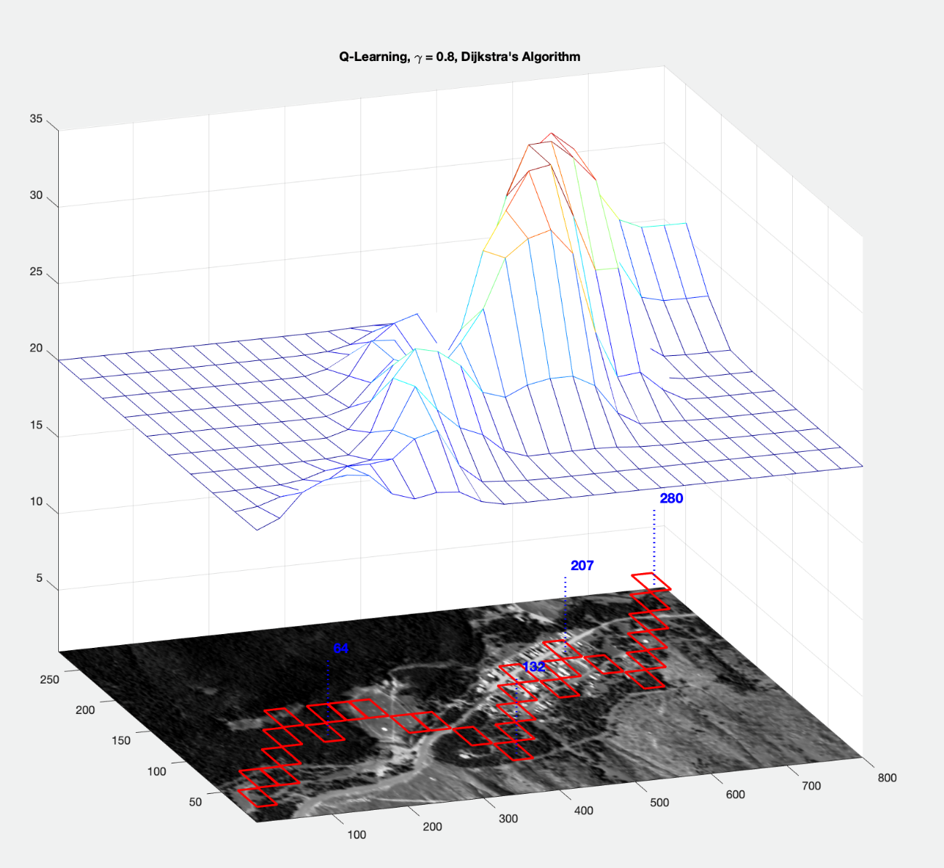

Optimal Pathway – Human Value Field
Q-Learning
γ = 0.8
Dijkstra’s Algorithm
Follows the ‘value ridge’ closely rather than looping down near 700
Q-learning, γ = 0.8 case

Slide 29
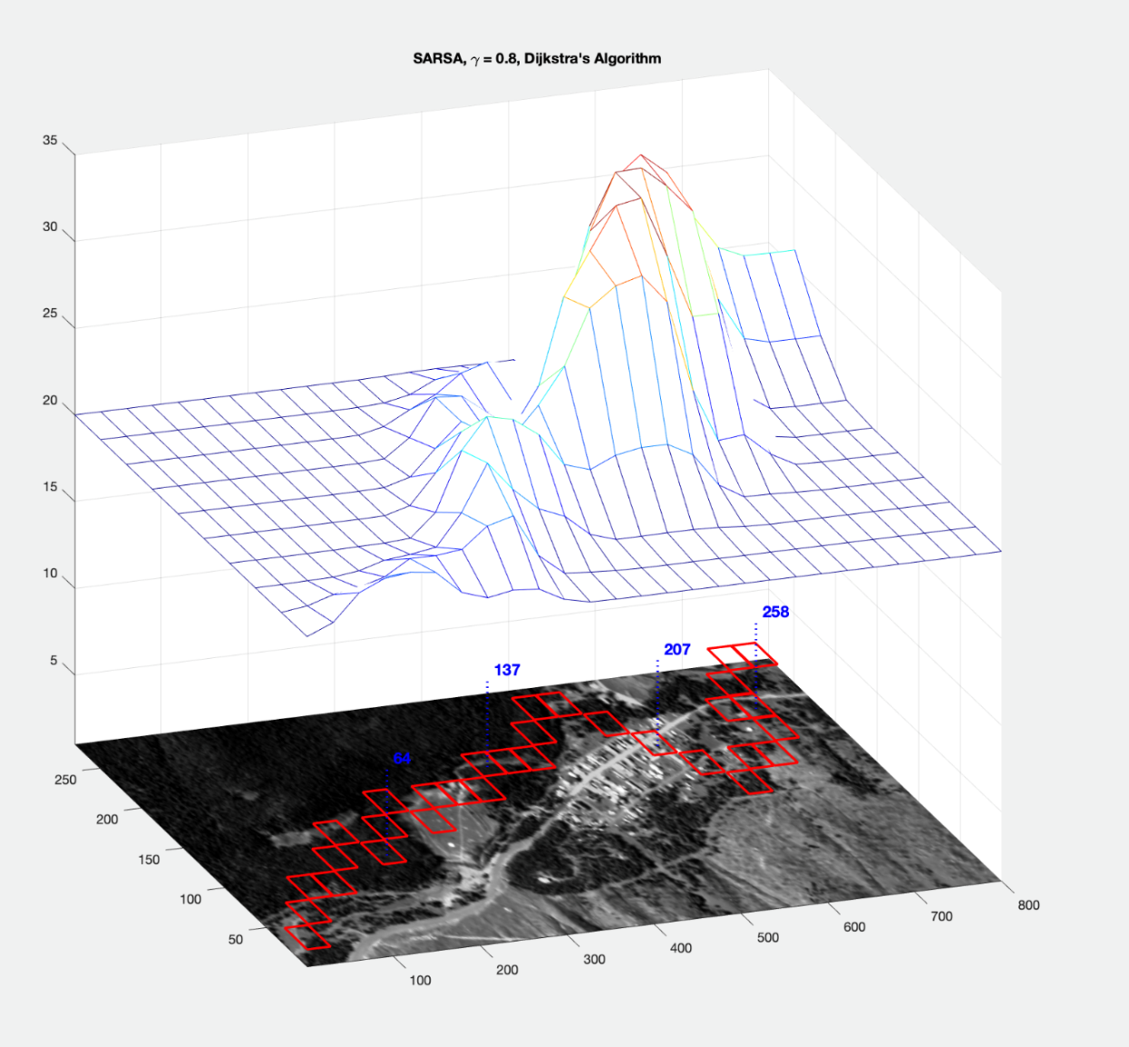

Optimal Pathway – Human Value Field
SARSA
γ = 0.8
Dijkstra’s Algorithm
No downward loop at
400 suggesting a
least step principle
when compared to
Q-Learning, Dijk. Alg., γ = 0.8

Slide 30
Conclusions
Feature extraction algorithms based on spectral image processing can create meaningful value fields which map into reward fields to be used in reinforcement learning
SARSA and Q-Learning with variable γ, the maximal action policy, and the Dijkstra algorithm can produce optimal least cost pathways which provide rational decision making capability
Human value field assessment also plays a role in value and reward field estimation important to spatial optimization
Algorithms in principle can be applied to high resolution imagery data to find optimal state/actions for MMPs

Slide 32
Reinforcement Learning: Q-Learning and SARSA
Interact and learn from the environment what path is best!
Supervised Learning
Training Info = desired inputs and outputs
Classical
Learning
E.g. Fuzzy Logic
Supervised
Learning
System
Outputs
(features/class)
Inputs
Reinforcement learning
Evaluations (rewards/penalties)
Non-Classical
Learning
RL Systems
Environment
Inputs
Outputs (actions)

Slide 33
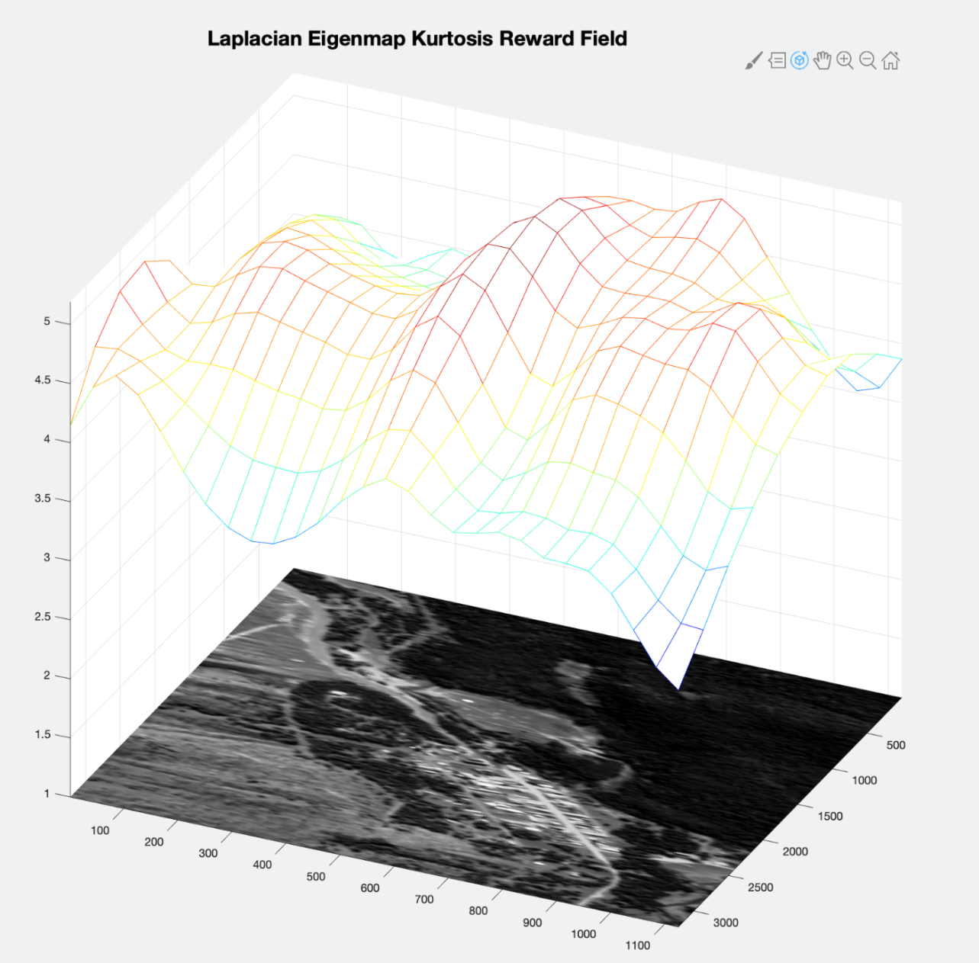
Example Value Field – Laplacian EigenFace
High Value ~
Low Kurtosis~
bldg. & paved
road spec. sig.

Slide 34
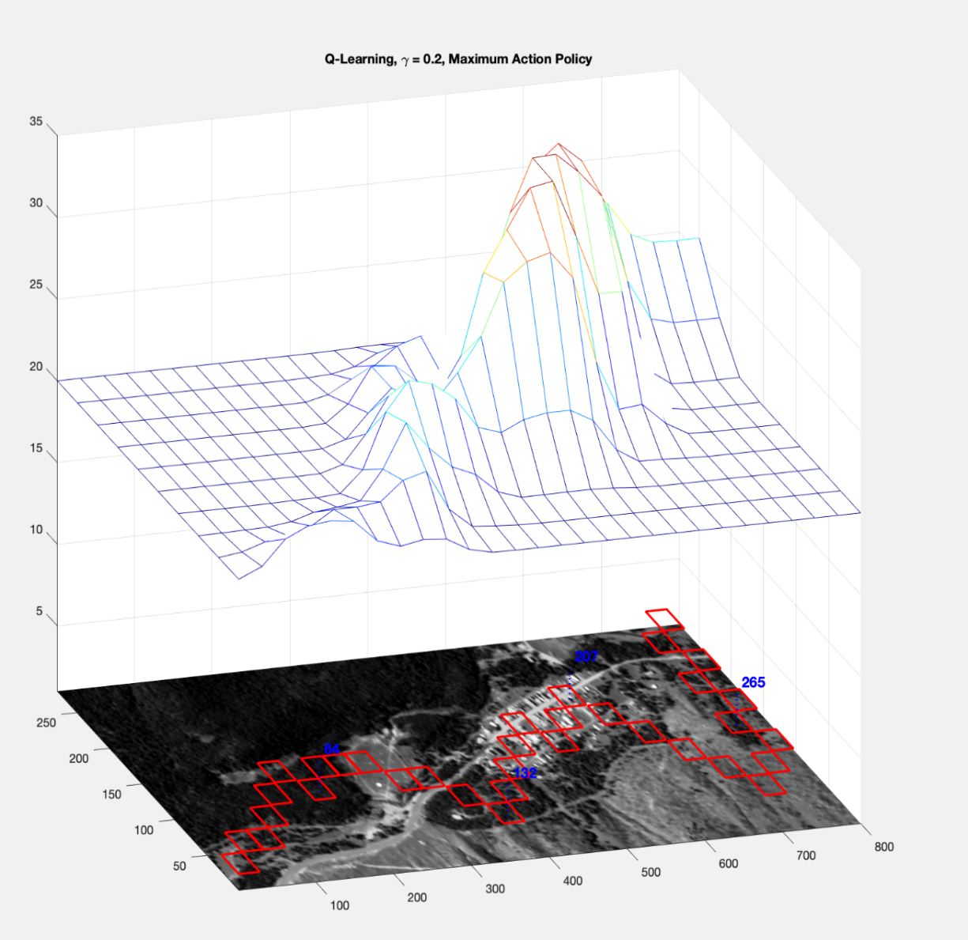

Optimal Pathway – Human Value Field
Q-Learning γ = 0.2
Maximum Action
Policy
Full exploration of nodal state space similar to Q-learning, γ = 0.8 case
Q-Learning, γ = 0.8

